Slide 1
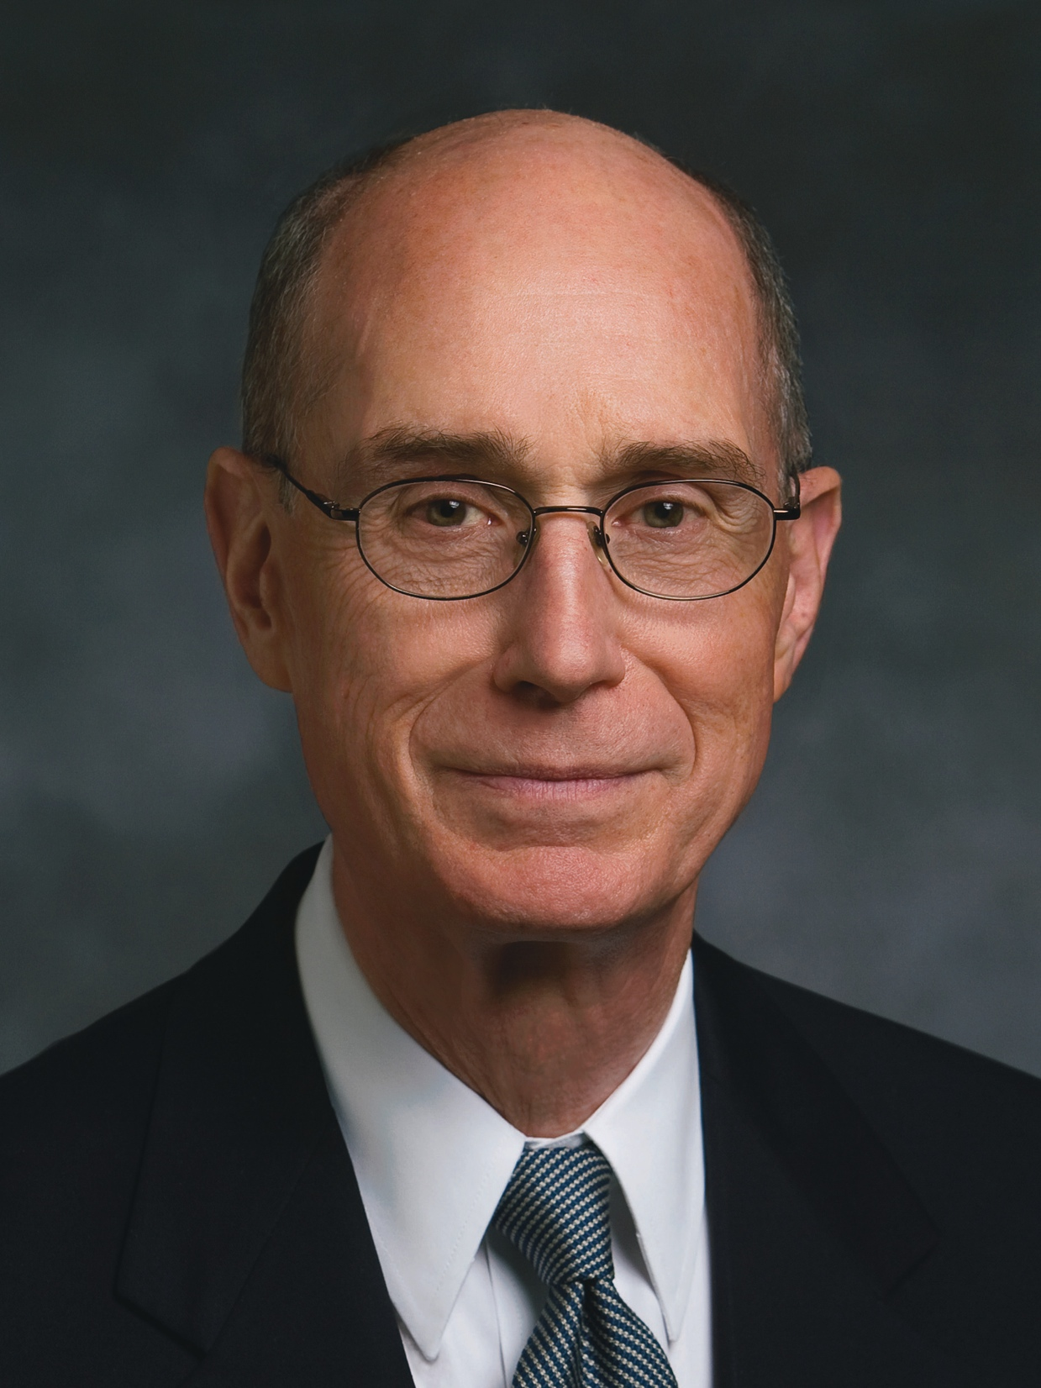
“We can unlock the power of the curriculum simply by acting on our faith that it is inspired of God. . . .
“Sticking with the content of the curriculum as well as its sequence will unlock our unique teaching gifts, not stifle them.”
Henry B. Eyring
“The Lord Will Multiply the Harvest” (evening with Elder Henry B. Eyring, Feb. 6, 1998), 4, 5

Slide 2
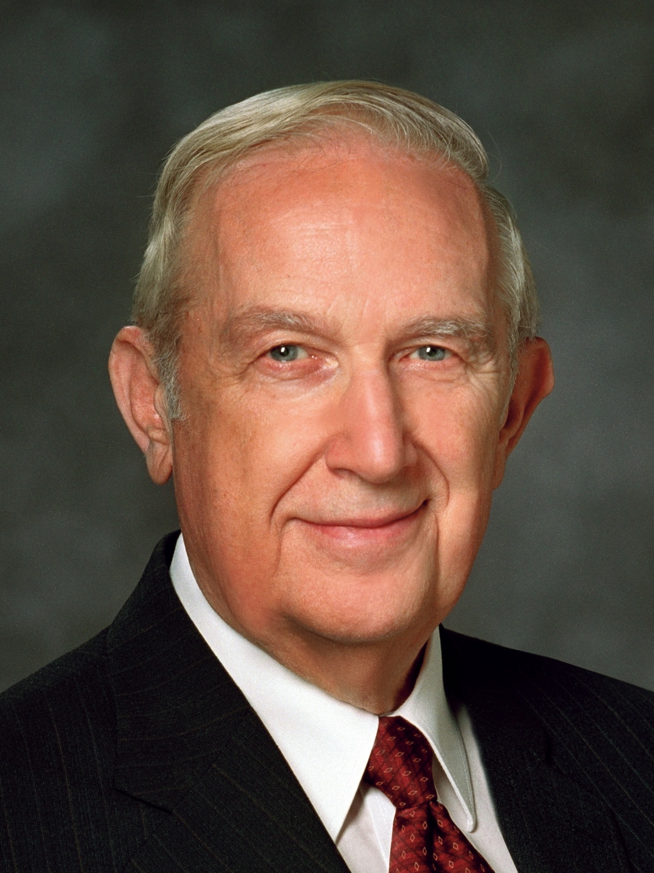
“When you face adversity, you can be led to ask many questions. Some serve a useful purpose; others do not. To ask, Why does this have to happen to me? Why do I have to suffer this, now? What have I done to cause this? will lead you into blind alleys. It really does no good to ask questions that reflect opposition to the will of God . . . .
Richard G. Scott
“Trust in the Lord,” Ensign, Nov. 1995, 17
1 of 4

Slide 3
Rather ask, What am I to do? What am I to learn from this experience? What am I to change? Whom am I to help? How can I remember my many blessings in times of trial? . . .
Richard G. Scott
“Trust in the Lord,” Ensign, Nov. 1995, 17
2 of 4

Slide 4
“This life is an experience in profound trust—trust in Jesus Christ, trust in His teachings, trust in our capacity as led by the Holy Spirit to obey those teachings. . . . To trust means to obey willingly without knowing the end from the beginning (see Prov. 3:5–7).
Richard G. Scott
“Trust in the Lord,” Ensign, Nov. 1995, 17
3 of 4

Slide 5
To produce fruit, your trust in the Lord must be more powerful and enduring than your confidence in your own personal feelings and experience.”
Richard G. Scott
“Trust in the Lord,” Ensign, Nov. 1995, 17
4 of 4

