Slide 1
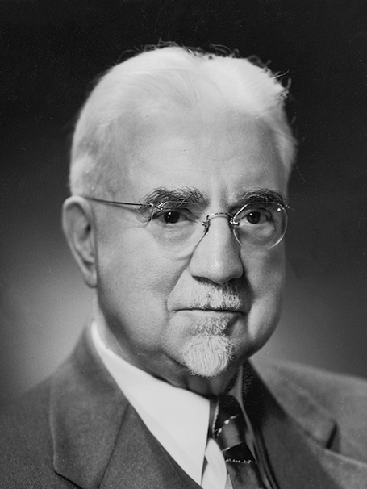
“A seer is one who sees with spiritual eyes. He perceives the meaning of that which seems obscure to others; therefore he is an interpreter and clarifier of eternal truth. He foresees the future from the past and the present. . . . In short, he is one who sees, who walks in the Lord’s light with open eyes. . . .
John A. Widtsoe
Evidences and Reconciliations, arr. G. Homer Durham, 3 vols. in 1 [1960], 258
1 of 2

Slide 2
“. . . A prophet is a teacher of known truth; a seer is a perceiver of hidden truth; a revelator is a bearer of new truth.”
John A. Widtsoe
Evidences and Reconciliations, arr. G. Homer Durham, 3 vols. in 1 (1960), 258
2 of 2

