Slide 1
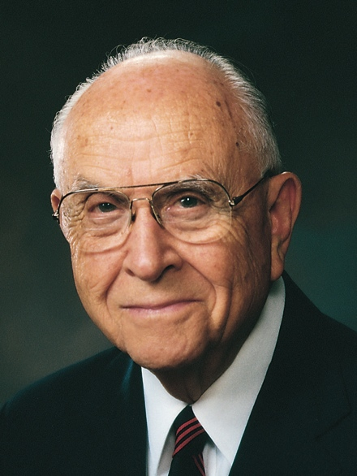
“The moment we step into the house of the Lord, the atmosphere changes from the worldly to the heavenly, where respite from the normal activities of life is found, and where peace of mind and spirit is received. It is a refuge from the ills of life and a protection from the temptations that are contrary to our spiritual well-being.”
David B. Haight
“Temples and the Work Therein,” Ensign, Nov. 1990, 61

Slide 2
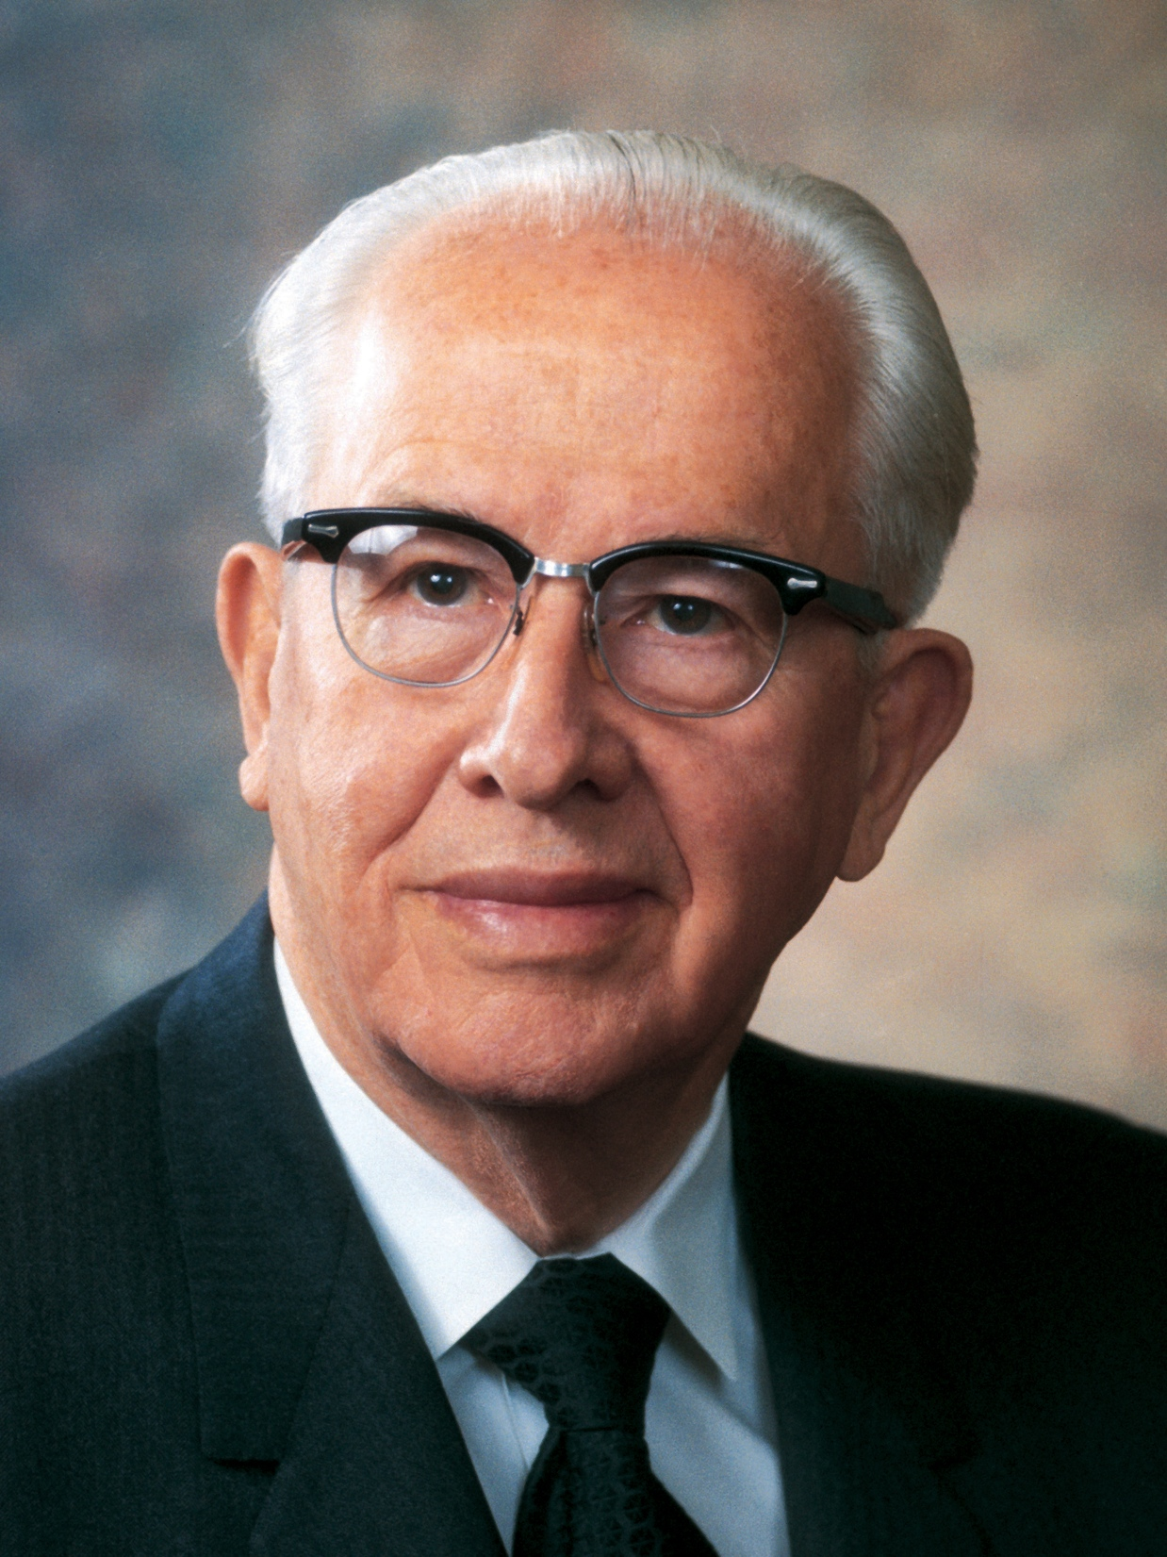
“Men and women who turn their lives over to God will find out that he can make a lot more out of their lives than they can. He will deepen their joys, expand their vision, quicken their minds, strengthen their muscles, lift their spirits, multiply their blessings, increase their opportunities, comfort their souls, raise up friends, and pour out peace.”
Ezra Taft Benson
“Jesus Christ—Gifts and Expectations,” New Era, May 1975, 20

Slide 3
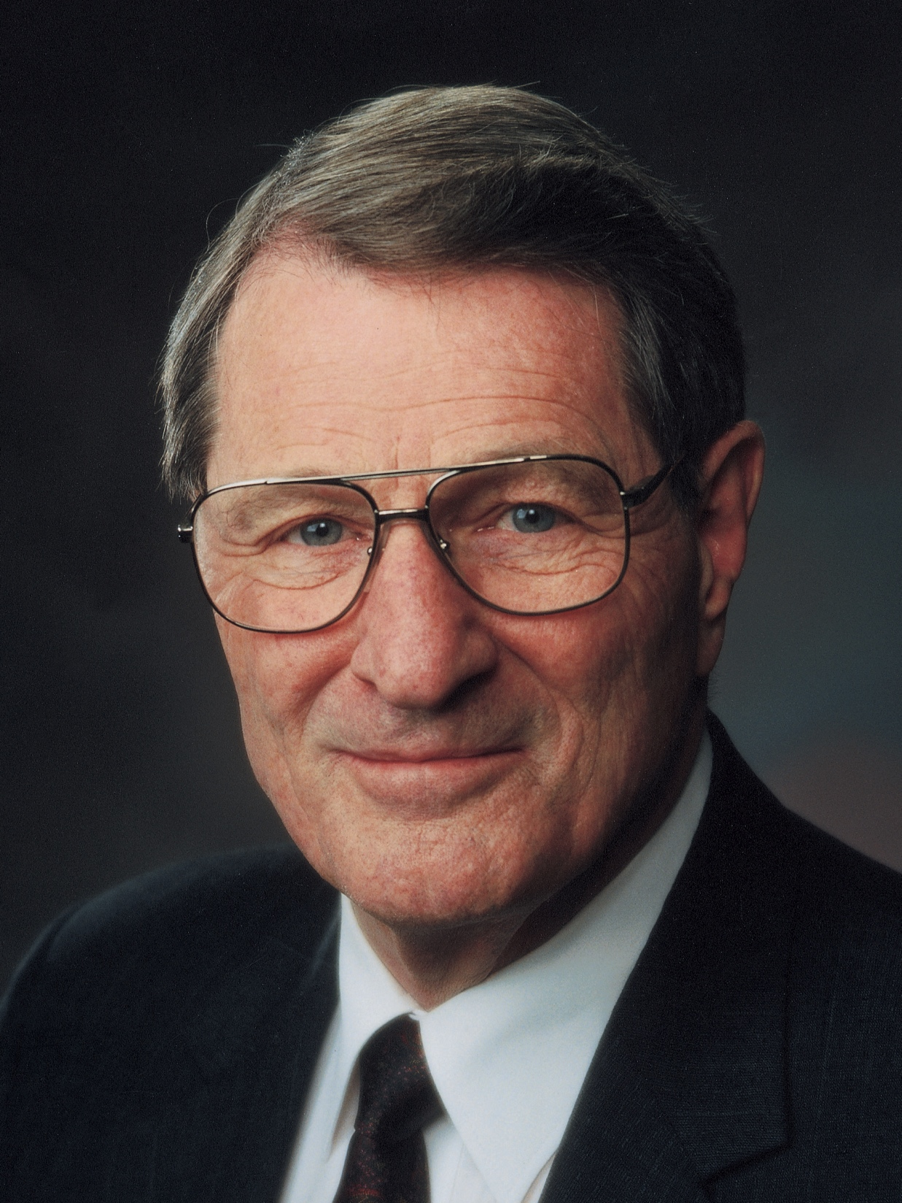
“In the anguishing process of repentance, we may sometimes feel God has deserted us. The reality is that our behavior has isolated us from Him. Thus, while we are turning away from evil but have not yet turned fully to God, we are especially vulnerable.
Neal A. Maxwell
“Repentance,” Ensign, Nov. 1991, 31
1 of 2

Slide 4
Yet we must not give up, but, instead, reach out to God’s awaiting arm of mercy, which is outstretched ‘all the day long.’ (Jacob 5:47; 6:4; 2 Ne. 28:32; Morm. 5:11.)”
Neal A. Maxwell
“Repentance,” Ensign, Nov. 1991, 31
2 of 2

