Slide 1
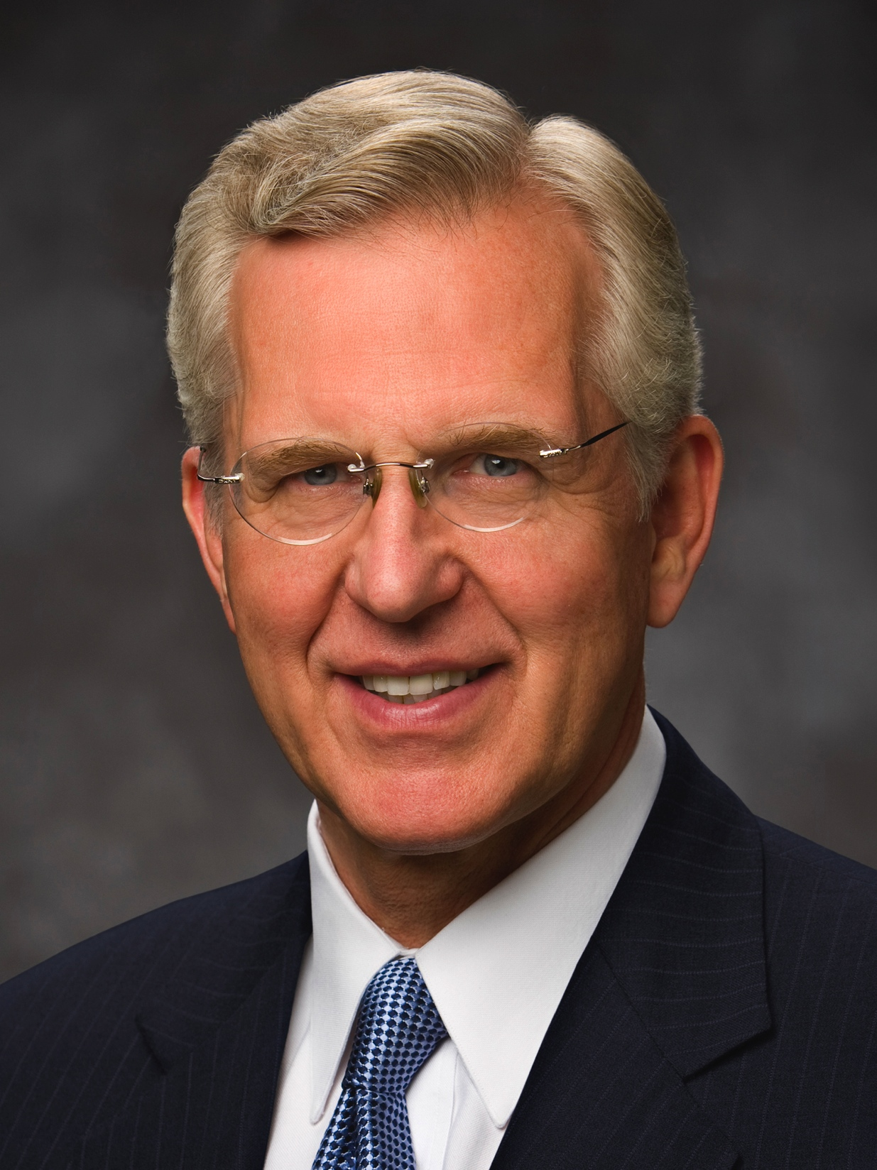
Elder D. Todd Christofferson of the Quorum of the Twelve Apostles taught that although “we generally interpret the word fear as ‘respect’ or ‘reverence’ or ‘love,’” we should also “so love and reverence Him that we fear doing anything wrong in His sight.”
D. Todd Christofferson
“A Sense of the Sacred,” (Church Educational System fireside for young adults, Nov. 7, 2004), 6, 7
1 of 2

Slide 2
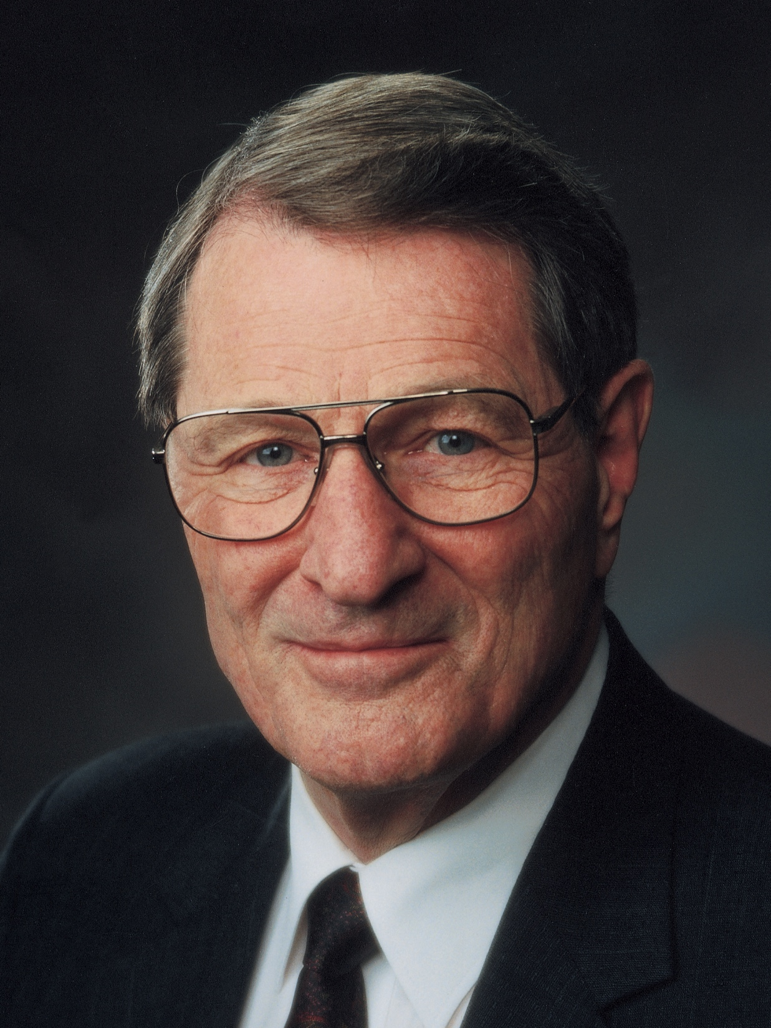
“The submission of one’s will is really the only uniquely personal thing we have to place on God’s altar. The many other things we ‘give,’ brothers and sisters, are actually the things He has already given or loaned to us.
Neal A. Maxwell
“Swallowed Up in the Will of the Father,” Ensign, Nov. 1995, 24
1 of 2

Slide 3
However, when you and I finally submit ourselves, by letting our individual wills be swallowed up in God’s will, then we are really giving something to Him!”
Neal A. Maxwell
“Swallowed Up in the Will of the Father,” Ensign, Nov. 1995, 24
2 of 2

Slide 4
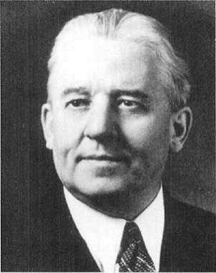
“In that hour I think I can see our dear Father behind the veil looking upon these dying struggles. . . . His great heart almost breaking for the love that He had for His Son. Oh, in that moment when He might have saved His Son, I thank Him and praise Him that He did not fail us. . . .
Melvin J. Ballard
in Crusader for Righteousness (1966), 137
1 of 3

Slide 5
I rejoice that He did not interfere, and that His love for us made it possible for Him to endure to look upon the sufferings of His [Only Begotten] and give Him finally to us, our Saviour and our Redeemer.
Melvin J. Ballard
in Crusader for Righteousness (1966), 137
2 of 3

Slide 6
Without Him, without His sacrifice, . . . we would never have come glorified into His presence. . . . This is what it cost, in part, for our Father in heaven to give the gift of His Son unto men.”
Melvin J. Ballard
in Crusader for Righteousness (1966), 137
3 of 3

