Slide 2
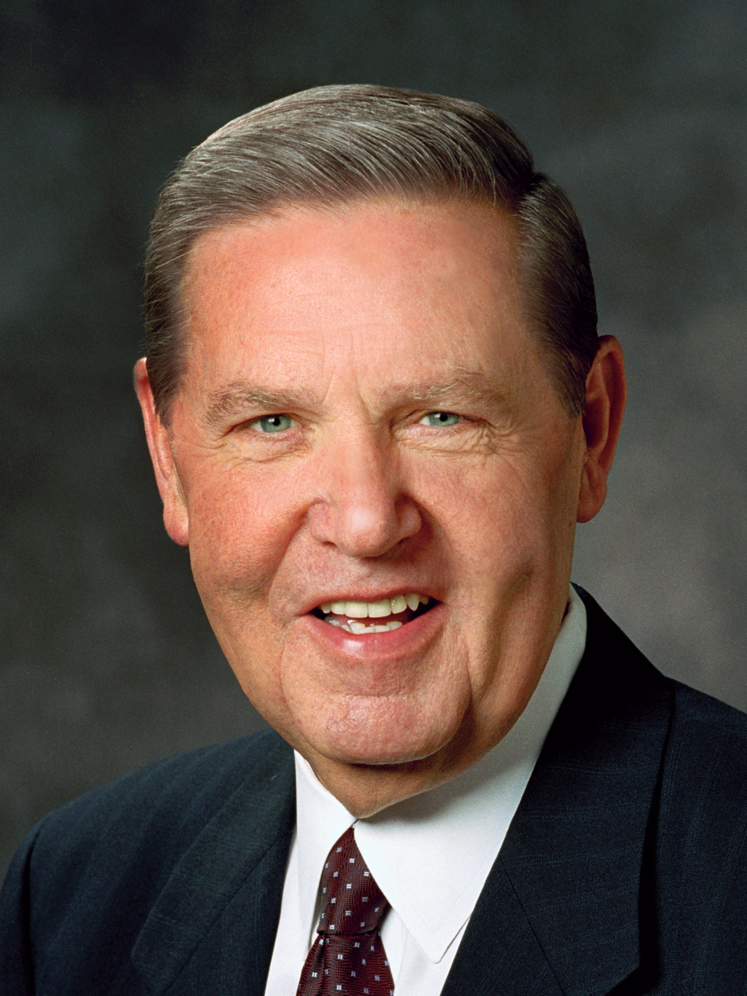
“Please know that your Father in Heaven loves you and so does His Only Begotten Son. When They speak to you—and They will—it will not be in the wind, nor in the earthquake, nor in the fire, but it will be with a voice still and small, a voice tender and kind.”
Jeffrey R. Holland
“The Tongue of Angels,” Ensign or Liahona, May 2007, 18

Slide 3
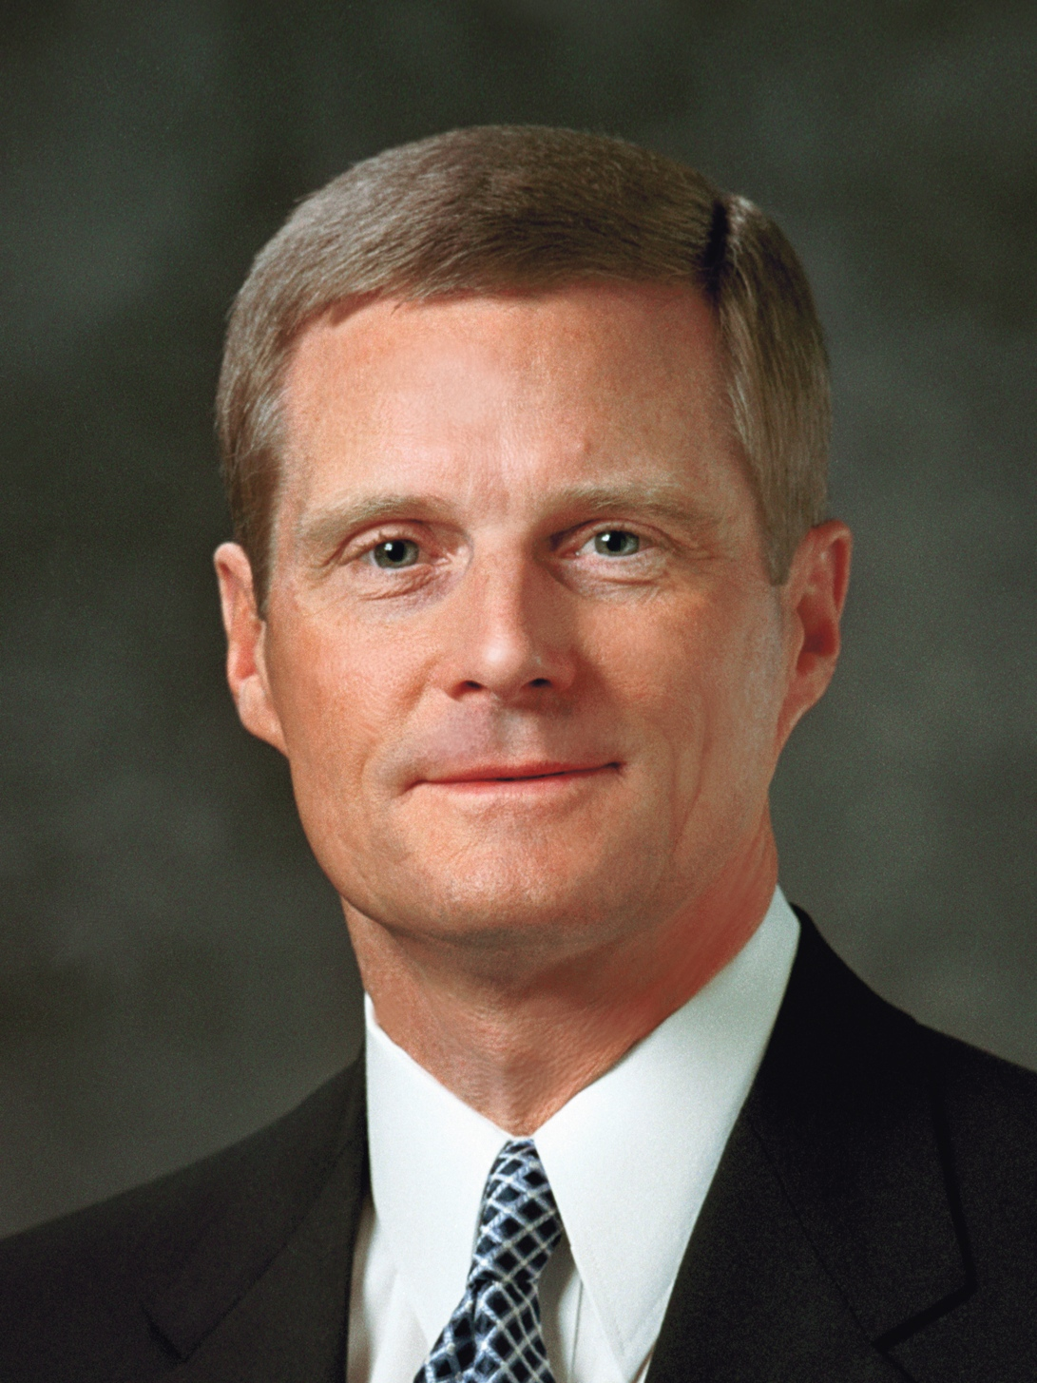
“A learner exercising agency by acting in accordance with correct principles opens his or her heart to the Holy Ghost and invites His teaching, testifying power, and confirming witness. Learning by faith requires spiritual, mental, and physical exertion and not just passive reception. . . . “. . . A student must exercise faith and act in order to obtain the knowledge for himself or herself.”
David A. Bednar
“Seek Learning by Faith,” Ensign, Sept. 2007, 64

