Slide 1
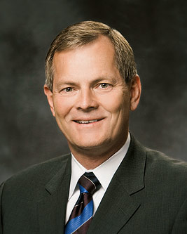
“There will be times when you . . . will have to demonstrate your righteous courage in plain view of your peers, the consequence of which may be ridicule and embarrassment. . . . He will reward you for your courage and righteous behavior—with happiness and joy.
Gary E. Stevenson
“Be Valiant in Courage, Strength, and Activity,” Ensign or Liahona, Nov. 2012, 52
1 of 2

Slide 2
Such courage will be a byproduct of your faith in Jesus Christ and His Atonement, your prayers, and your obedience to commandments.”
Gary E. Stevenson
“Be Valiant in Courage, Strength, and Activity,” Ensign or Liahona, Nov. 2012, 52
2 of 2

