Slide 1
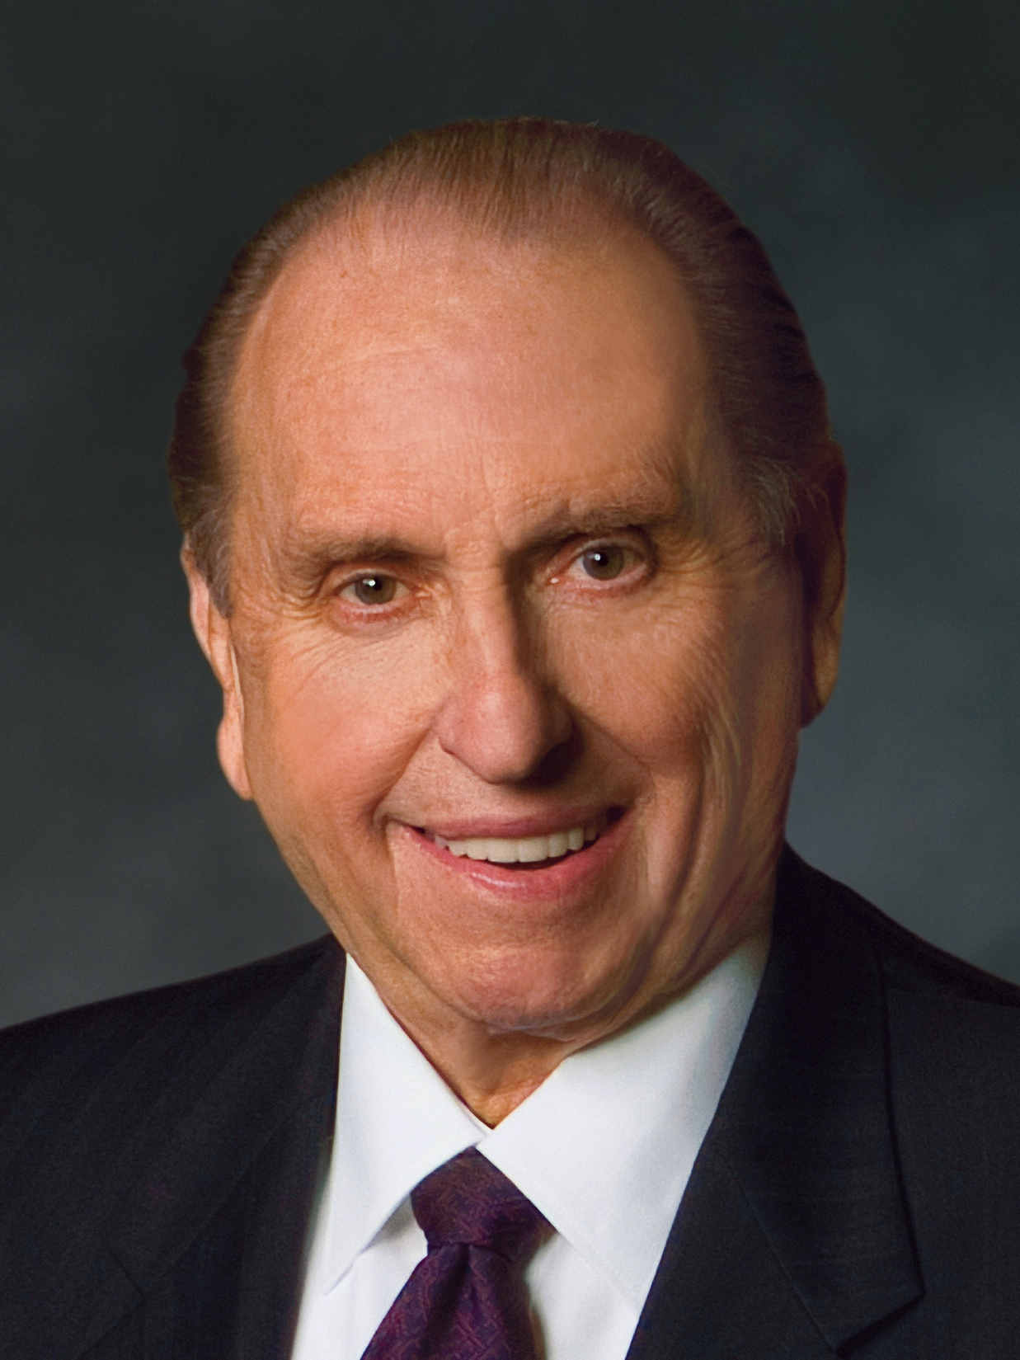
“Although the world has changed, the laws of God remain constant. They have not changed; they will not change. The Ten Commandments are just that—commandments. They are not suggestions. They are every bit as requisite today as they were when God gave them to the children of Israel.”
Thomas S. Monson
“Stand In Holy Places,” Ensign or Liahona, Nov. 2011, 83

Slide 2
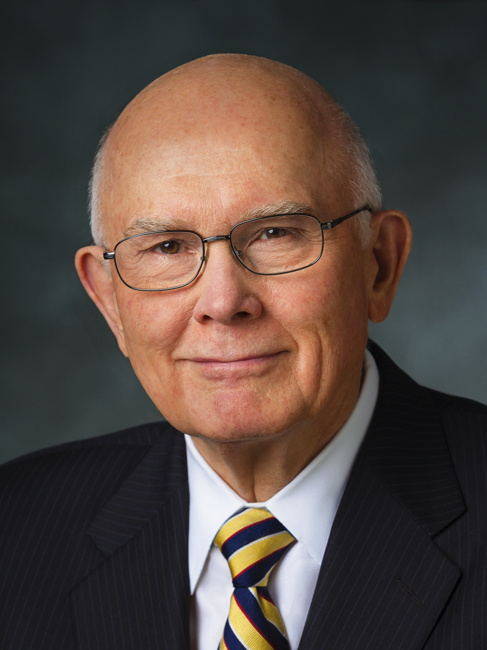
“The meaning of jealous is revealing. Its Hebrew origin means ‘possessing sensitive and deep feelings’ (Exodus 20:5, footnote b). Thus we offend God when we ‘serve’ other gods—when we have other first priorities.”
Dallin H. Oaks
“No Other Gods,” Ensign or Liahona, Nov. 2013, 72

Slide 3
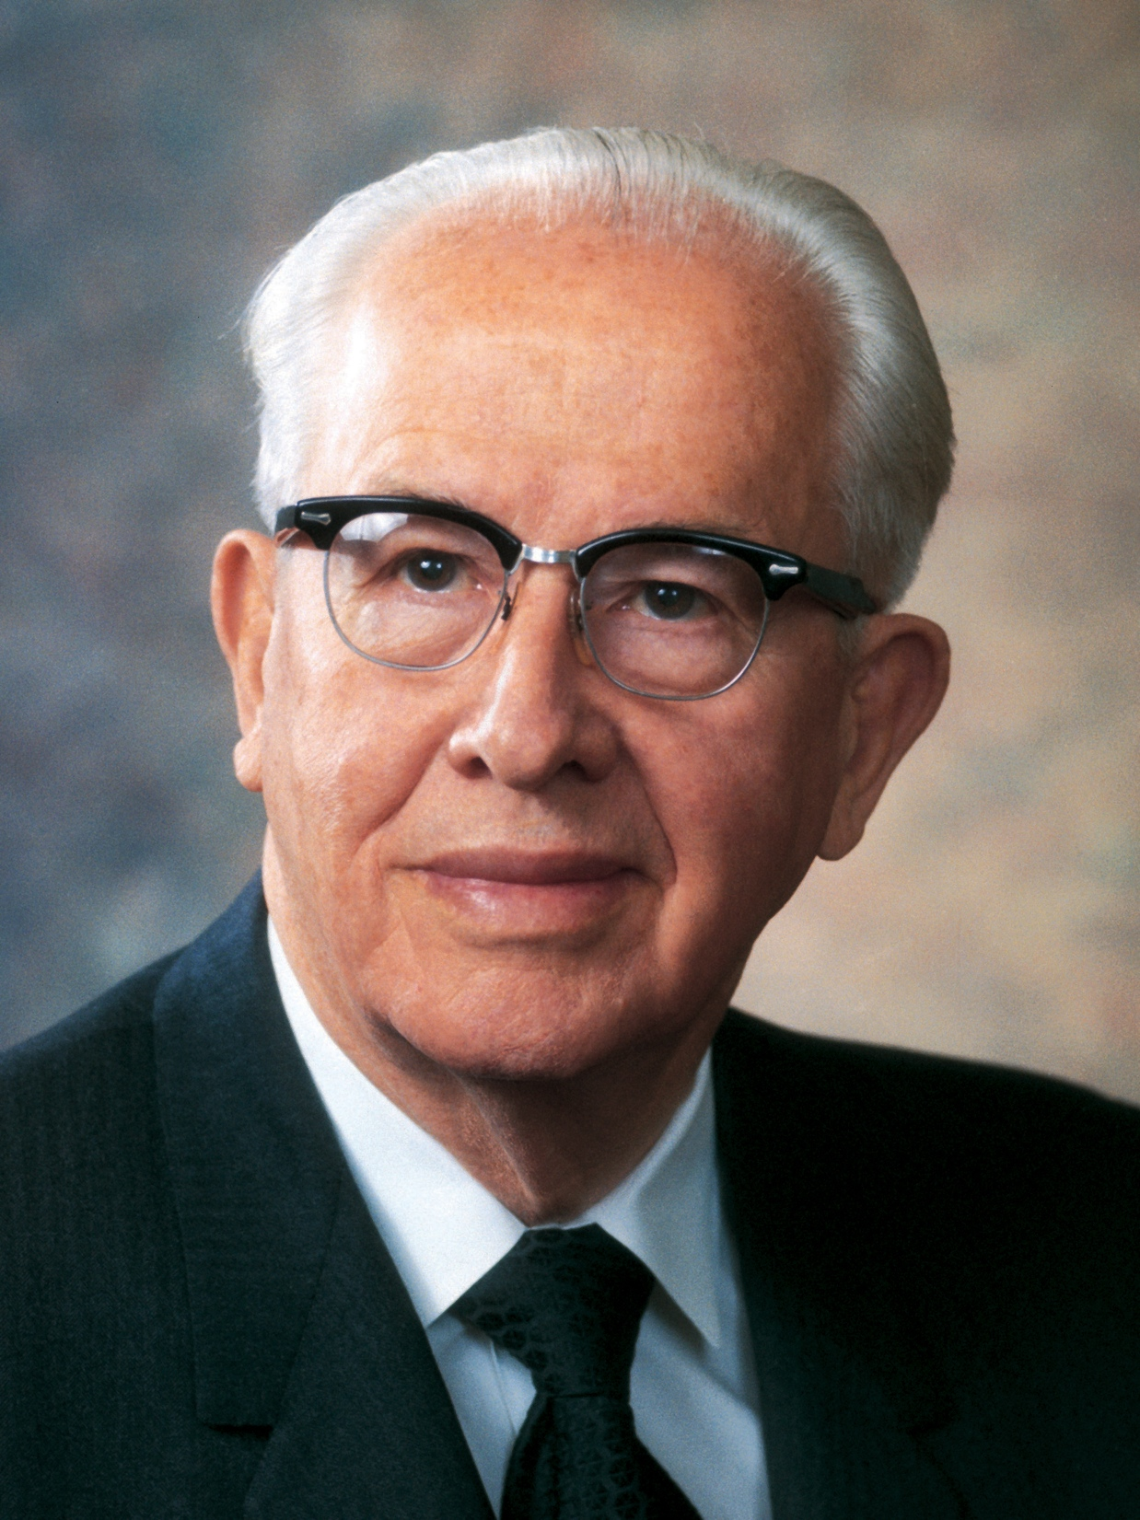
“When we put God first, all other things fall into their proper place or drop out of our lives. Our love of the Lord will govern the claims for our affection, the demands on our time, the interests we pursue, and the order of our priorities.”
Ezra Taft Benson
“The Great Commandment—Love the Lord,” Ensign, May 1988, 4

