Slide 1
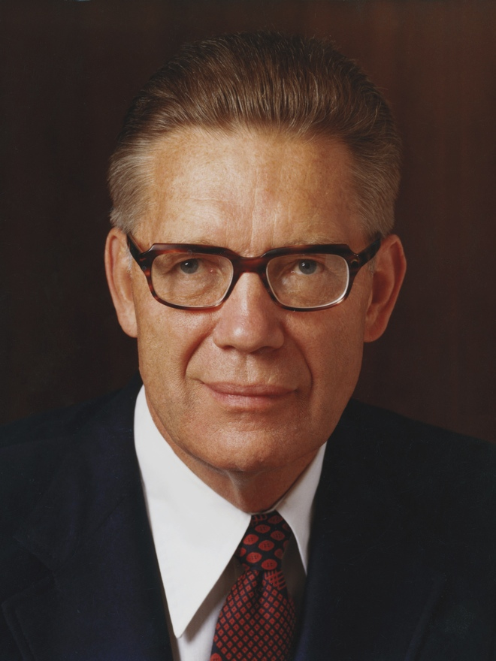
“This earth, all men [and women], animals, fish, fowls, plants, all things—all lived first as spirit entities. Their home was heaven, and the earth was created to be the place where they could take upon themselves mortality.”
Bruce R. McConkie
“Christ and the Creation,” Ensign, June 1982, 86
1 of 2

Slide 2
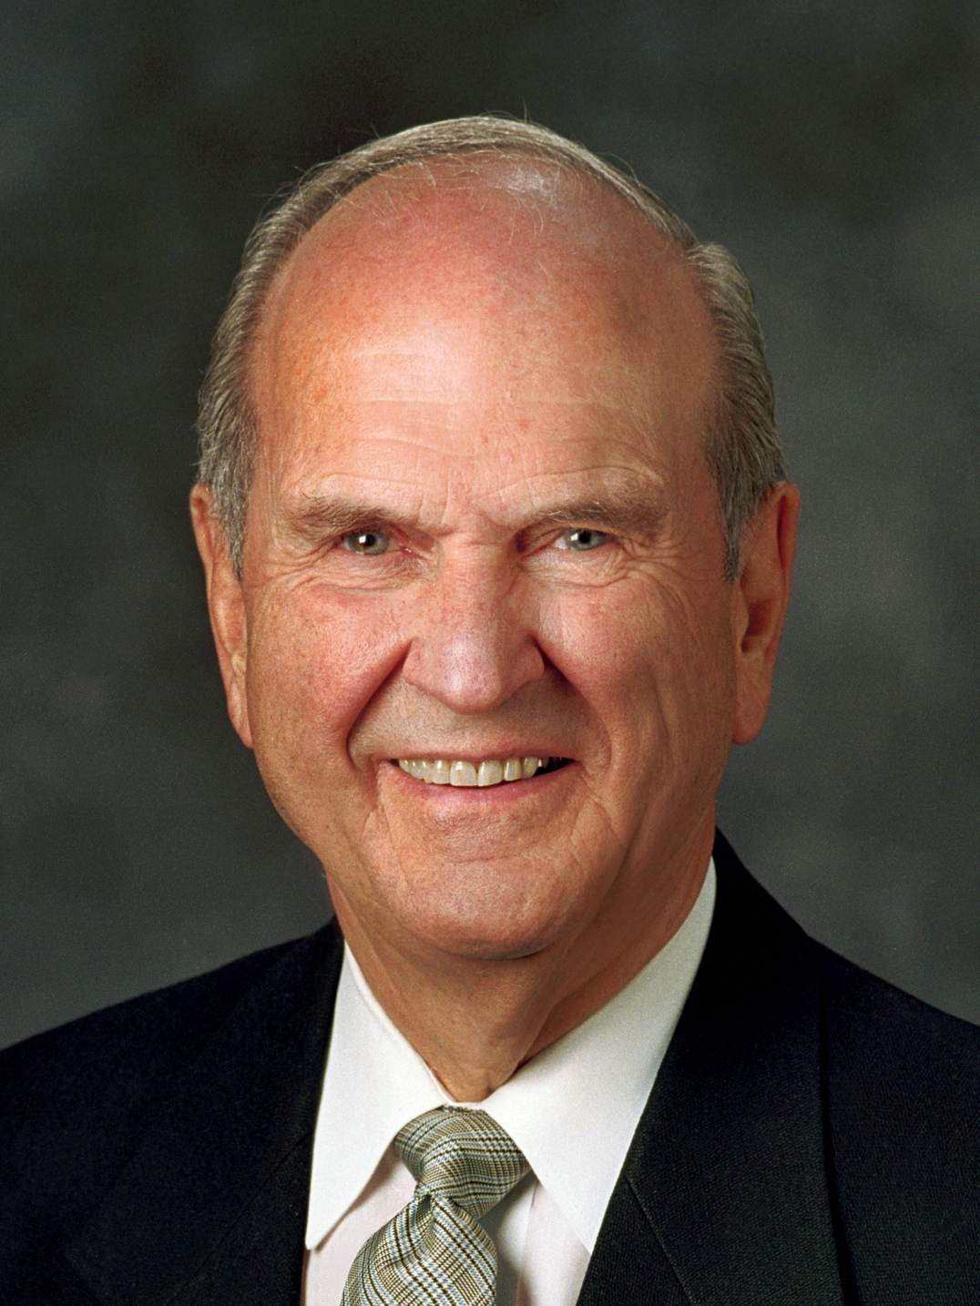
“The rib, coming as it does from the side, seems to denote partnership. The rib signifies . . . a lateral relationship as partners, to work and to live, side by side.”
Russell M. Nelson
“Lessons from Eve,” Ensign, Nov. 1987, 87

Slide 3
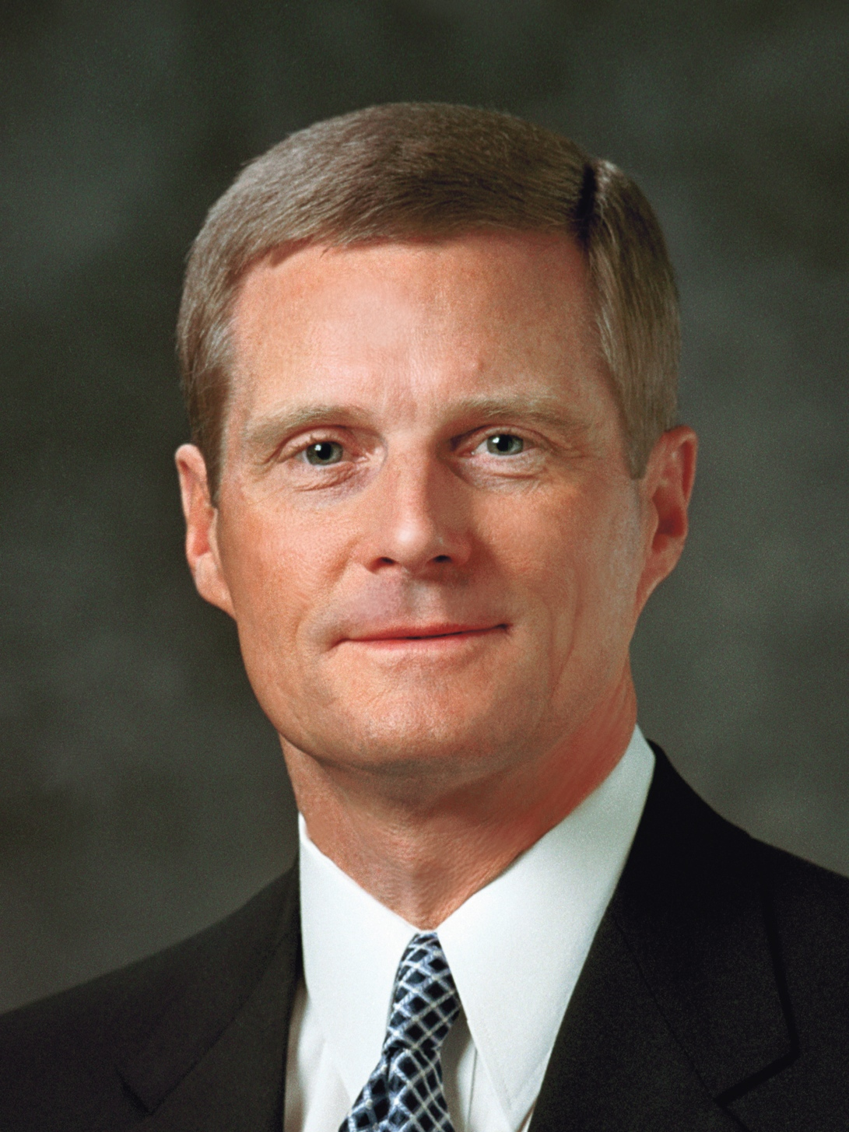
“Two compelling doctrinal reasons help us to understand why eternal marriage is essential to the Father’s plan. “Reason 1: The natures of male and female spirits complete and perfect each other, and therefore men and women are intended to progress together toward exaltation.
David A. Bednar
“Marriage Is Essential to His Eternal Plan,” Ensign, June 2006, 82–84; see also “The Family: A Proclamation to the World,” Ensign or Liahona, Nov. 2010, 129
1 of 6

Slide 4
“. . . For divine purposes, male and female spirits are different, distinctive, and complementary. “. . . The unique combination of spiritual, physical, mental, and emotional capacities of both males and females were needed to implement the plan of happiness. Alone, neither the man nor the woman could fulfill the purposes of his or her creation.
David A. Bednar
“Marriage Is Essential to His Eternal Plan,” Ensign, June 2006, 82–84; see also “The Family: A Proclamation to the World,” Ensign or Liahona, Nov. 2010, 129
2 of 6

Slide 5
“. . . Because of their distinctive temperaments and capacities, males and females each bring to a marriage relationship unique perspectives and experiences. The man and the woman contribute differently but equally to a oneness and a unity that can be achieved in no other way. The man completes and
David A. Bednar
“Marriage Is Essential to His Eternal Plan,” Ensign, June 2006, 82–84; see also “The Family: A Proclamation to the World,” Ensign or Liahona, Nov. 2010, 129
3 of 6

Slide 6
perfects the woman and the woman completes and perfects the man as they learn from and mutually strengthen and bless each other. ‘Neither is the man without the woman, neither the woman without the man, in the Lord’ (1 Corinthians 11:11; italics added).
David A. Bednar
“Marriage Is Essential to His Eternal Plan,” Ensign, June 2006, 82–84; see also “The Family: A Proclamation to the World,” Ensign or Liahona, Nov. 2010, 129
4 of 6

Slide 7
“Reason 2: By divine design, both a man and a woman are needed to bring children into mortality and to provide the best setting for the rearing and nurturing of children. . . . “A home with a loving and loyal husband and wife is the supreme setting in which children can be reared in love and righteousness and
David A. Bednar
“Marriage Is Essential to His Eternal Plan,” Ensign, June 2006, 82–84; see also “The Family: A Proclamation to the World,” Ensign or Liahona, Nov. 2010, 129
5 of 6

Slide 8
in which the spiritual and physical needs of children can be met. Just as the unique characteristics of both males and females contribute to the completeness of a marriage relationship, so those same characteristics are vital to the rearing, nurturing, and teaching of children.”
David A. Bednar
“Marriage Is Essential to His Eternal Plan,” Ensign, June 2006, 82–84; see also “The Family: A Proclamation to the World,” Ensign or Liahona, Nov. 2010, 129
6 of 6

